Slide 1
An introduction to Friend Functions
There will be times when you want a function to have access to the private members of a class without that function actually being a member of that class.
C++ supports friend functions.
A friend is not a member of a class but still has access to its private elements.
Two reasons that friend functions are useful have to do with operator overloading and creation of certain types of I/O functions.

Slide 2
An introduction to Friend Functions
However, a third reason for friend functions is that there will be a times when you want one function to have access to the private members of two or more different class.
A friend function is defined as a regular nonmember function.
However, inside the class declaration for which it will be a friend, its prototype is also included, preface by the keyword friend.

Slide 3
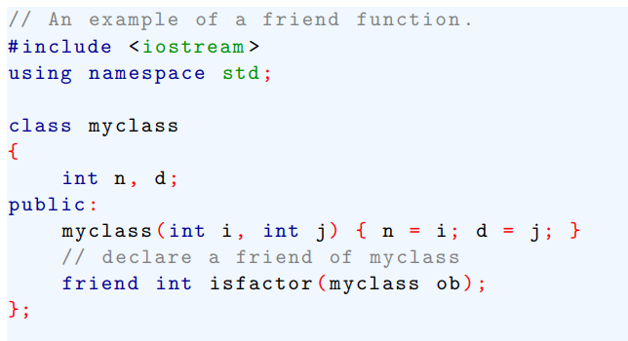
An introduction to Friend Functions
To understand how this works, examine this short program

Slide 4
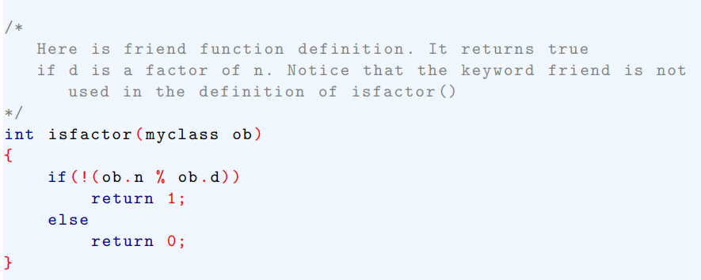
An introduction to Friend Functions

Slide 5
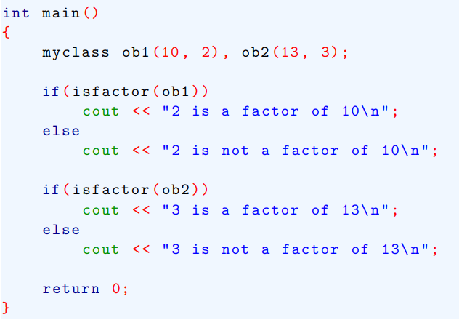
An introduction to Friend Functions

Slide 6
An introduction to Friend Functions
It is important to understand that a friend function is not a member of the class for which it is friend .
Thus, it is not possible to call a friend function by using an object name and a class member access operator .

Slide 7
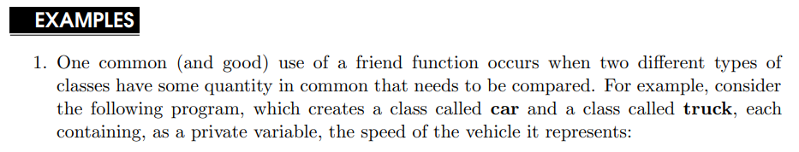
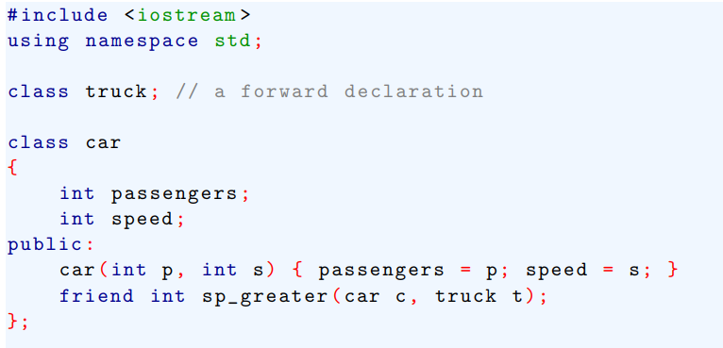
An introduction to Friend Functions

Slide 8

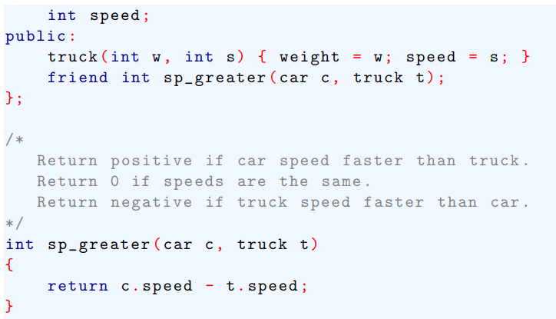
An introduction to Friend Functions

Slide 9
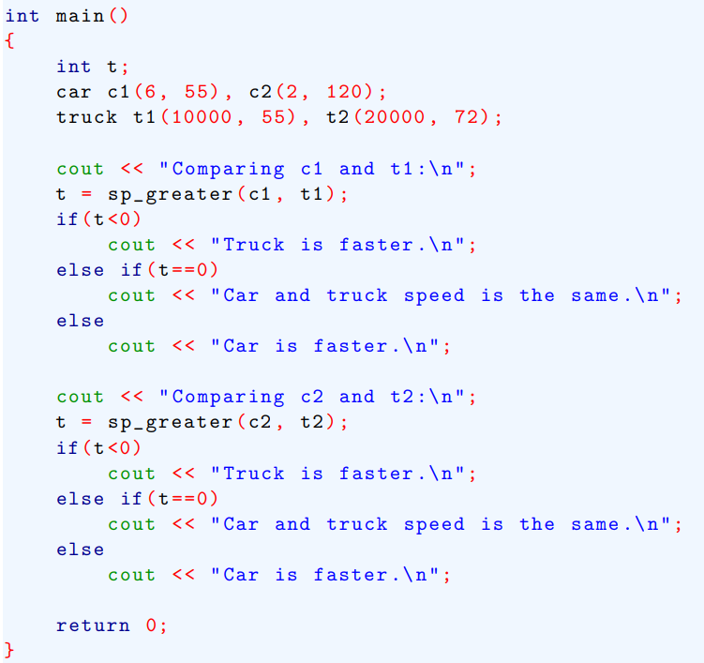
An introduction to Friend Functio

Slide 10
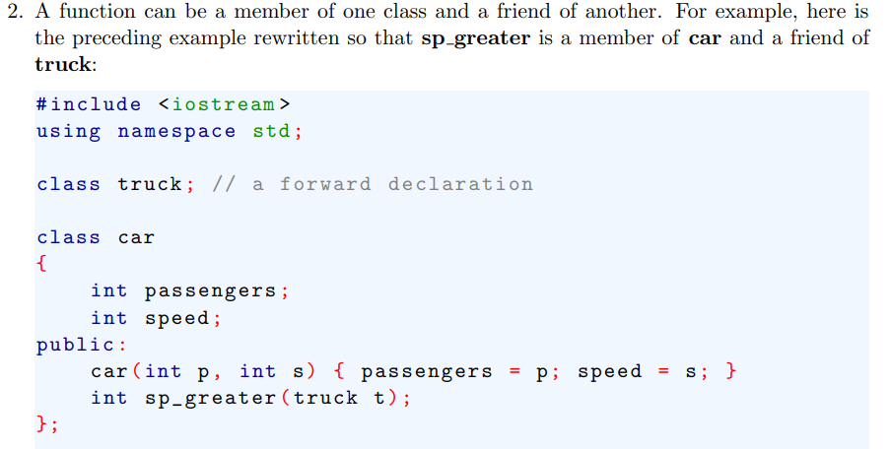
An introduction to Friend Functions

Slide 11
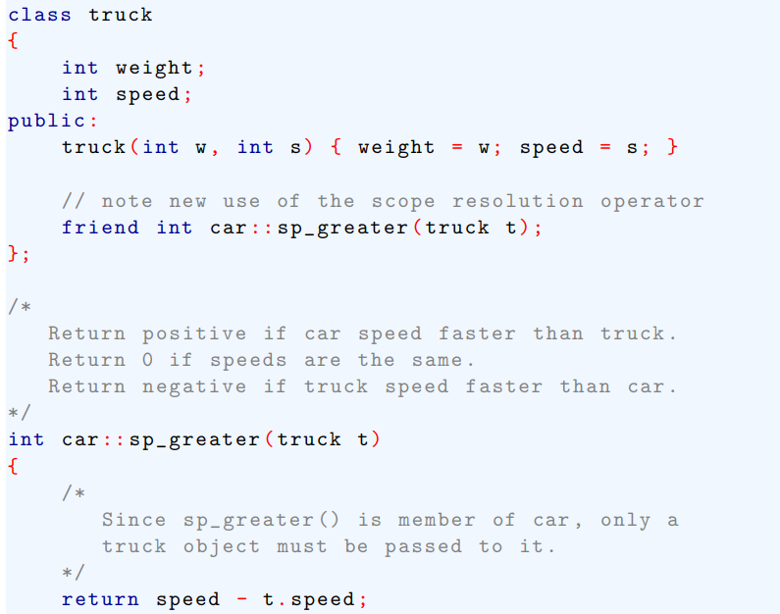
An introduction to Friend Functions

Slide 12
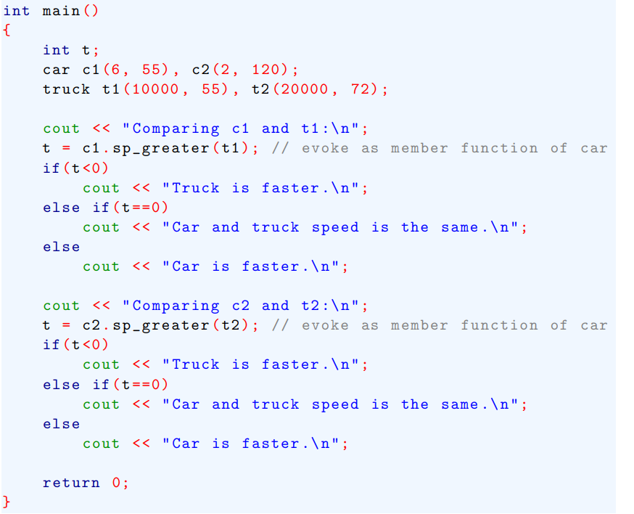
An introduction to Friend Functions

